Slide 1
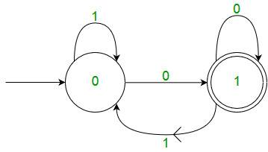
DFA

Slide 2
Deterministic Finite Automata
The finite Automata are called deterministic finite automata if the m/c reads an i/p string one symbol at a time
Deterministic refers to uniqueness of the computation
In DFA there is only path for specific input from the current state to the next state
DFA does not accept the null move, ie it can not change state without any input character
Can have multiple final states
Used in Lexical Analysis in complier
3

Slide 3
Definition of DFA
A Deterministic Finite Automata has 5-tuples
M = (Q,Σ,δ,qo,F)
Q: finite set called the states
Σ: finite set called the alphabets
δ: transition specifying from which state on which input symbol where the transition goes (QxΣ)
qo: initial state
F: set of final states
3

Slide 4
Graphical representation of DFA
The state is represented by vertices
The arc labelled with an i/p character show the transition
The initial state is marked with an arrow
The final state is denoted by double circle
3

Slide 5
Acceptance of Language
A language acceptance is defined if a string “w” is accepted by a machine M ie if it is reaching the final state by taking the string “w”
Not accepted if not reaching the final state
3

Slide 6
Example of DFA
Q. Let DFA be Q={a,b,c} qo= {a} Σ={0,1} F={C}
Present state | 0 | 1
a | a | b
b | c | a
C* | b | c
3

Slide 7
Example of DFA
Q. Design DFA with Σ={0,1} accepts the strings which start with 1 and ends with 0.
3

Slide 8
Example of DFA
Q. Design DFA that checks whether the given 2-bit binary number is even or odd.
3

Slide 9
Example of DFA
Q. Design DFA with Σ={a,b} that accepts the strings with only one ‘b’ in the string
3

Slide 10
Example of DFA
Q. Design DFA with Σ={0,1} accepts the strings with odd no’s 0’s or even no’s of 1
3

Slide 11
Example of DFA
3

Slide 12
Example of DFA
Q. Design DFA with Σ={0,1} accepts the strings with odd no’s 0’s and even no’s of 1
3

