Slide 1
Secure Hash Algorithm
Ms. Swati Mali
swatimali@gmail.com
Assistant Professor
Department of Computer Engineering
K. J. Somaiya College of Engineering
Somaiya Vidyavihar University

Slide 2
Features of SHA-512
a hashing algorithm used to convert text of any length into a fixed-size string.
Each output produces a SHA-512 length of 512 bits (64 bytes).
This algorithm is commonly used for
email addresses hashing,
password hashing,
and digital record verification.
With a message digest of 512 bits, SHA-512 expected to be resistant to all attacks, including collision attacks.

Slide 3
SHA 512 working

Slide 4
SHA-512 stages
Input formatting
Hash buffer initialization
Message Processing
Output

Slide 5
Input formatting
SHA-512 can’t actually hash a message input of any size, i.e. it has an input size limit.
Message has basically three parts:
the original message,
padding bits,
size of original message.
Combined size of the whole message must be multiple of 1024 bits.
Message is processed as blocks of 1024 bits each, so each bock should have 1024 bits to work with

Slide 6
Input formatting.. contd
Padding bits to get message of the desired length.
The bits that are used for padding are simply ‘0’ bits with a leading ‘1’ (100000…000).
Also, according to the algorithm, padding needs to be done, even if it is by one bit.
So a single padding bit would only be a ‘1’.
The total size should be equal to 128 bits short of a multiple of 1024 since the goal is to have the formatted message size as a multiple of 1024 bits (N x 1024).

Slide 7
Padding

Slide 8
Input formatting.. contd
Padding size
Original message size : represented in 128 bits
The only reason that the SHA-512 has a limitation for its input message.
The largest number that can be represented using 128 bits is (2¹²⁸-1), the message size can be at most (2¹²⁸-1) bits;
2¹²⁸-2 = 340,282,366,920,938,463,463,374,607,431,768,211,454 bits

Slide 12
12.2.1 Continued
Example 12.3
What is the number of padding bits if the length of the original message is 2590 bits?
Solution
We can calculate the number of padding bits as follows:
The padding consists of one 1 followed by 353 0’s.

Slide 13
12.2.1 Continued
Example 12.4
Do we need padding if the length of the original message is already a multiple of 1024 bits?
Solution
Yes we do, because we need to add the length field. So padding is needed to make the new block a multiple of 1024 bits.

Slide 14
12.2.1 Continued
Example 12.5
What is the minimum and maximum number of padding bits that can be added to a message?
Solution
The minimum length of padding is 0 and it happens when (−M − 128) mod 1024 is 0. This means that |M| = −128 mod 1024 = 896 mod 1024 bits. In other words, the last block in the original message is 896 bits. We add a 128-bit length field to make the block complete.

Slide 15
Words
Figure 12.8 A message block and the digest as words

Slide 16
Step 2: Hash buffer initialization
processes each block of 1024 bits from the message using the result from the previous block.
What about the first block?
Use a default value to be used for the first block in order to start off the process. = IV
Store intermediate result that needs to be used in processing the next block in hash buffer
Also holds the final hash digest of the entire processing phase of SHA-512 as the last of these ‘intermediate’ results.

Slide 17
Initialization vector
IV is initialized with first 64 bits of the fractional parts of the square roots of the first 8 prime numbers (2,3,5,7,11,13,17,19).

Slide 18
Step 3: Message Processing
Message processing is done upon the formatted input by taking one block of 1024 bits at a time.
The actual processing takes place by using two things:
The 1024 bit block, and
the result from the previous processing.
This part of the SHA-512 algorithm consists of several ‘Rounds’ and an addition operation.
So, the Message block (1024 bit) is expanded out into ‘Words’ using a ‘message sequencer’.
16 Words to be precise, each of them having a size of 64 bits.

Slide 20
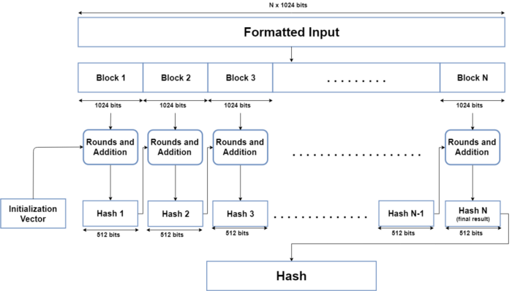

Slide 21
Message processing Rounds
Each round takes 3 things:
one Word,
the output of the previous Round,
and a SHA-512 constant.
The first Round doesn’t have a previous Round whose output it can use, so it uses the Initial Vector (IV)
SHA-512 constants are predetermined values, each of whom is used for each Round in the message processing phase. (First 64 bits from the fractional part of the cube roots of the first 80 prime numbers, one for each round)
Every round gives an output of 512 bits.
Total rounds = 80 Rounds.
After the 80th Round, its output is simply added to the result of the previous message processing phase to get the final result for this iteration of message processing.

Slide 22
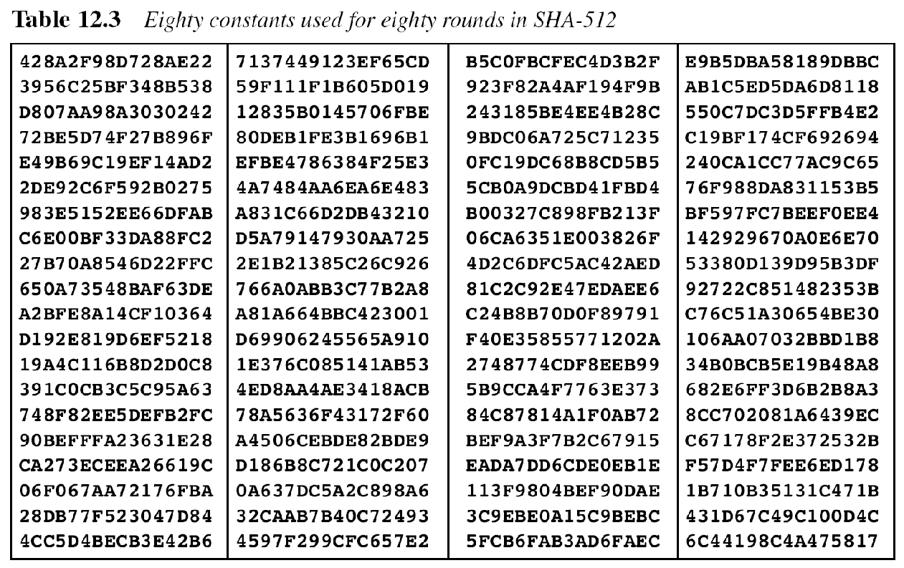

Slide 23
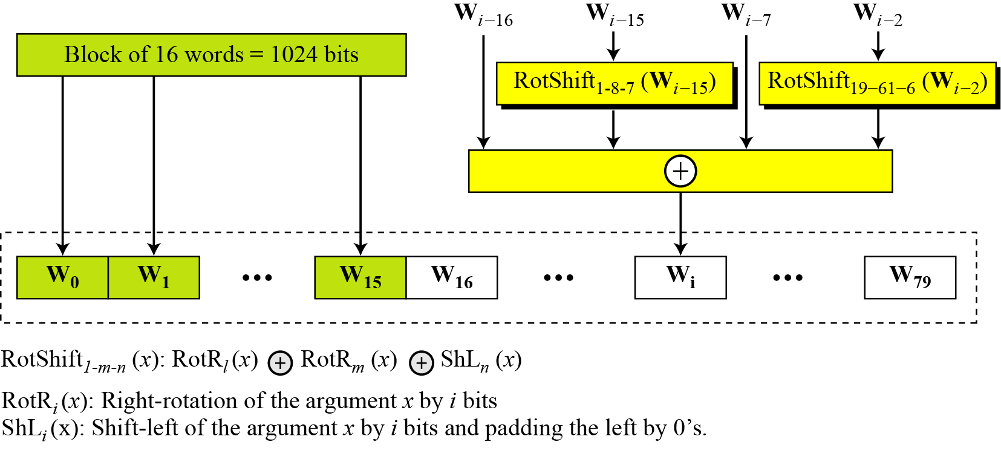
Word expansion for 80 rounds

Slide 24
12.2.1 Continued
Example 12.6
Show how W60 is made.
Solution
Each word in the range W16 to W79 is made from four previously-made words. W60 is made as

Slide 25
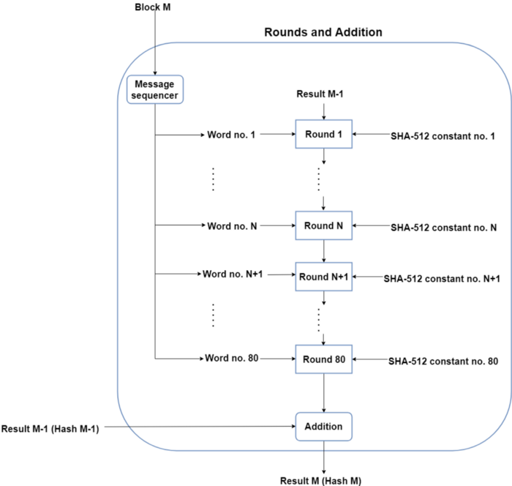

Slide 26
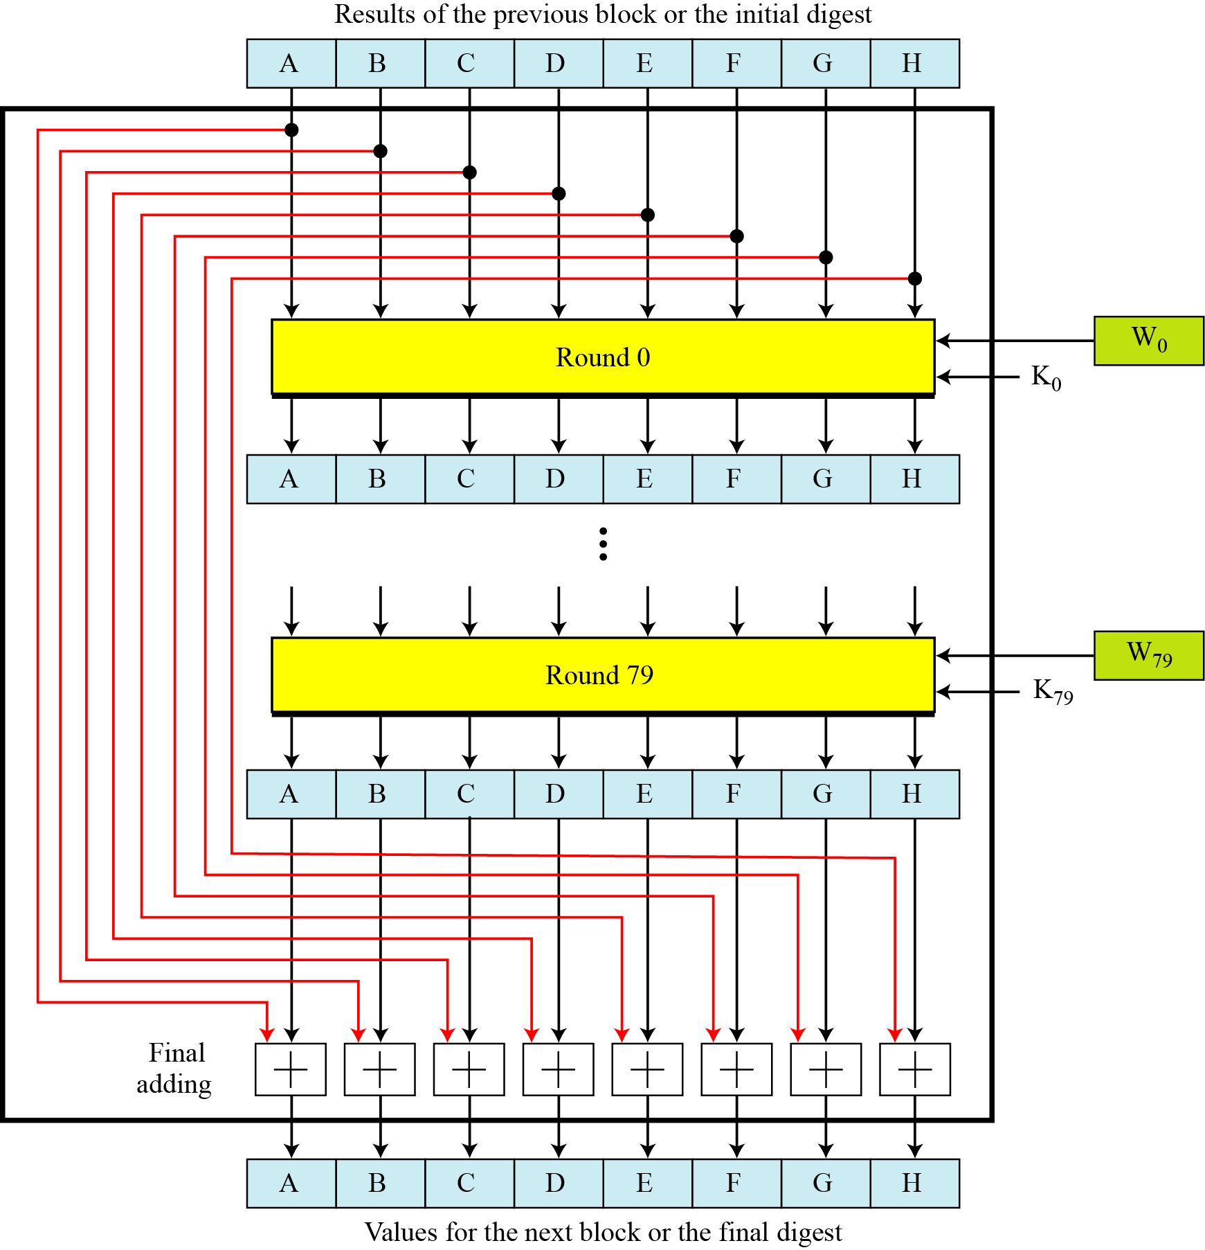
12.2.2 Compression Function
Figure 12.10 Compression function in SHA-512

Slide 27
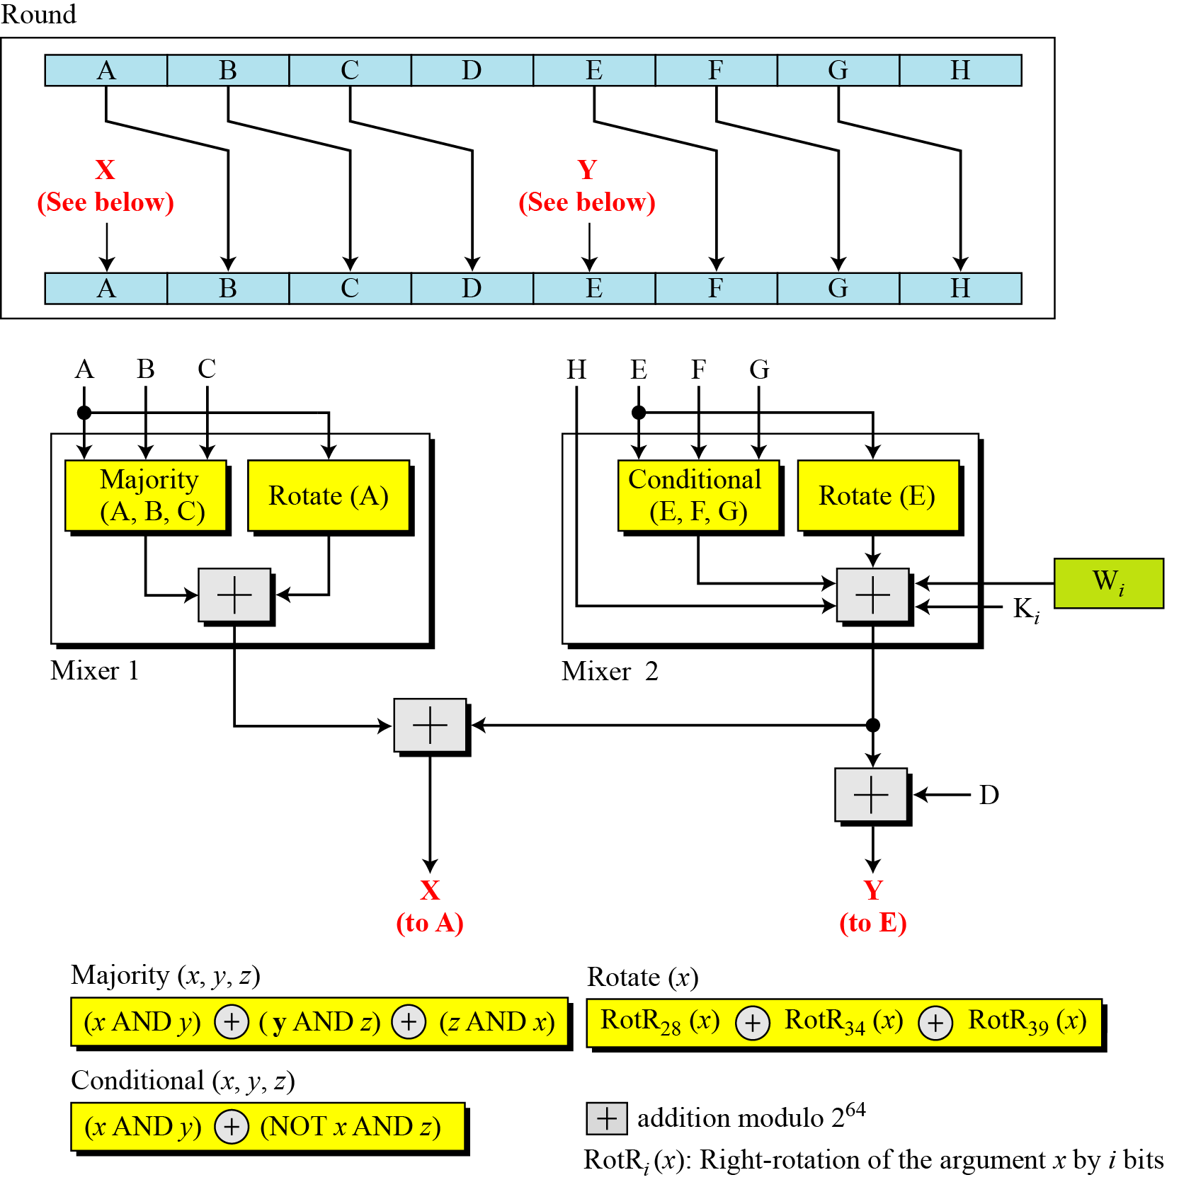
12.2.2 Continued
Figure 12.11 Structure of each round in SHA-512

Slide 28
12.2.2 Continued
Majority Function
Conditional Function
Rotate Functions

Slide 29
Step 4 : Output
After every block of 1024 bits goes through the message processing phase, i.e. the last iteration of the phase, we get the final 512 bit Hash value of our original message.
So, the intermediate results are all used from each block for processing the next block.
when the final 1024 bit block has finished being processed, we have with us the final result of the SHA-512 algorithm for our original message.

Slide 30
Blockchain Projects That Use The SHA 512
AlgorithmBitShares (BTS)
LBRY Credits (LBC)
Kcash (KCASH)

Slide 31
Non-Blockchain Applications For SHA-512
SHA-512 was used to authenticate archival video from the International Criminal Tribunal of the Rwandan genocide.
Unix and Linux vendors use both SHA-256 and SHA-512 for secure password hashing.
An email suppression list solution called OPTIZMO provides the storage and distribution of SHA-512 hashed email addresses for major clients such as Salesforce, LendingTree, Hotwire, and eharmony.

Slide 32
SHA 512
There are no known attacks against SHA-512, not against collision resistance and certainly not against first or second preimage resistance
doesn't have any known vulnerabilities that make it insecure and it has not been “broken” unlike some other popular hashing algorithms.
SHA-512 is faster than SHA-256.
Technically speaking SHA512 password hashes are not cracked or decrypted .

Slide 33
HMAC- Hash based message authentication code
Hash-based message authentication code(HMAC) is a mechanism for calculating a message authentication code involving a hash function in combination with a secret key.
This can be used to verify the integrity and authenticity of a message.
•HMACs are almost similar to digital signatures.
They both enforce integrity and authenticity.
They both use cryptography keys
And they both employ hash functions.
•The main difference is that digital signatures use asymmetric keys, while HMACs use symmetric keys (no publickey)

Slide 36
Symmetric encryption for message authentication
Message Authentication Code
Data Authentication Algorithm

Slide 37
Message Authentication
A message, file, document, or other collection of data is said to be authentic when it is genuine and came from its alleged source.
Message authentication is a procedure that allows communicating parties to verify that received message is authentic.
The important aspects are:
To verify that the contents of the message have not been altered
The source is authentic.
To verify a message’s timeliness and sequence relative to other messages flowing between two parties.

Slide 38
Techniques for message authentication
Encryption
MAC- Message authentication code- fixed length o/p
Hash(M) – Hash function – Fixed length output

Slide 39
1. Encryption
Symmetric Encryption
Shared key for encryption and decryption, both
Assumes only sender and receiver have the key 🡺 thereby given Authentication(!)

Slide 40
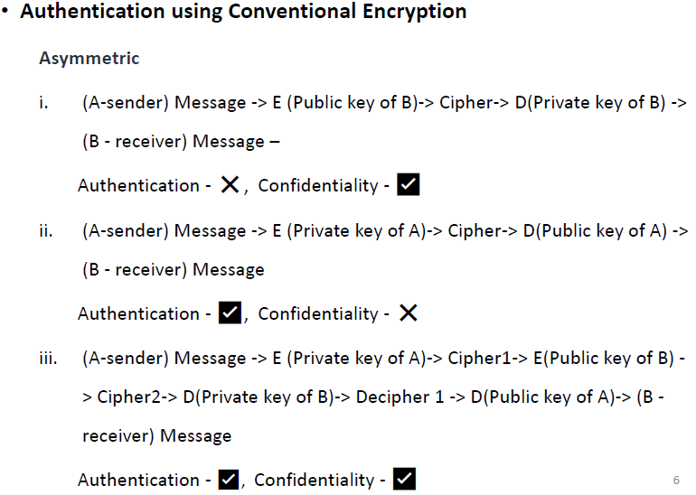

Slide 43
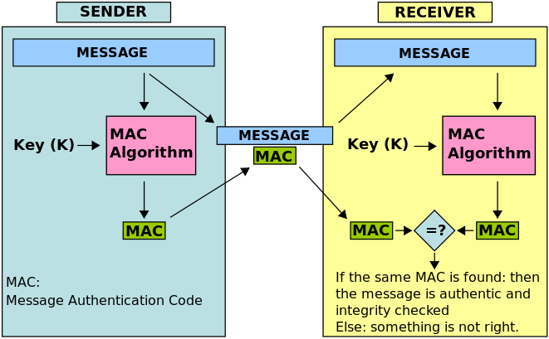

Slide 46
Message Authentication Code
To realize and construct MAC algorithms, two different cryptographic primitives are used.
MACs can be implemented using cryptographic hash functions or using symmetric block ciphers.
Cryptographic hash functions-HMAC
Symmetric block ciphers–
Data Authentication Algorithm,
Cipher based Message Authentication Code (CMAC)
CBC–MAC(it used AES)and
variant of CBC –MAC is CMAC (AES+tripleDES)

Slide 47
MAC Based on block ciphers
Data Authentication Algorithm (DAA)
Cipher based Message Authentication Code (CMAC)

Slide 48
DAA
The Data Authentication Algorithm (DAA) is a former U.S. government standard for producing cryptographic MACs.
DAA was withdrawn in September 2008.
The algorithm is not considered secure by today's standards.
According to the standard, a code produced by the DAA is called a Data Authentication Code (DAC).
The algorithm chain encrypts the data, with the last cipher block truncated and used as the DAC.

Slide 49
Data Authentication Algorithm (DAA) widely used MAC based on DES-CBC (Cipher block chaining)
The message to be authenticated is grouped into contiguous 64-bit blocks: D1,D2,…,DN.
The final block is padded on the right with zeros to form a full 64-bit block
Using DES encryption algorithm E and a secret key K, Data Authentication Code (DAC) is calculated.

Slide 50
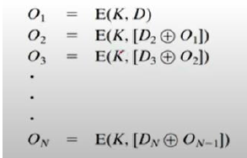
DAA

Slide 51
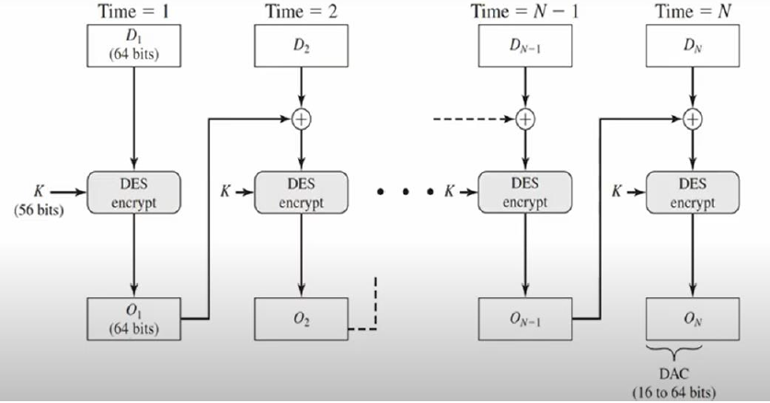
DAA working

Slide 52
Reading Assignment
MAC Vs DAA

Slide 53
Digital Signature

Slide 55
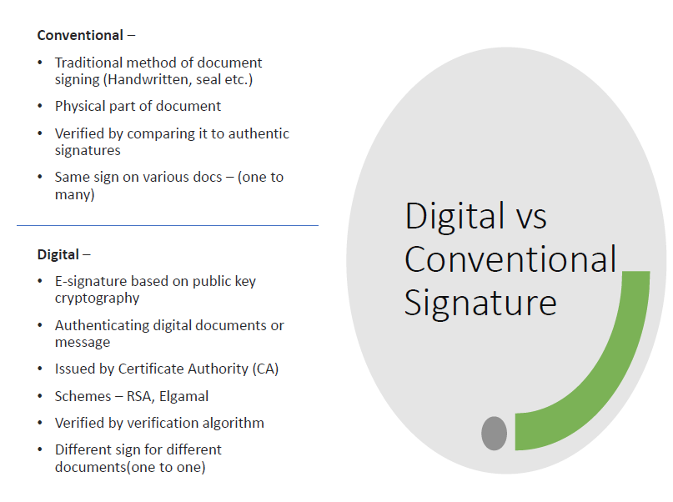

Slide 57
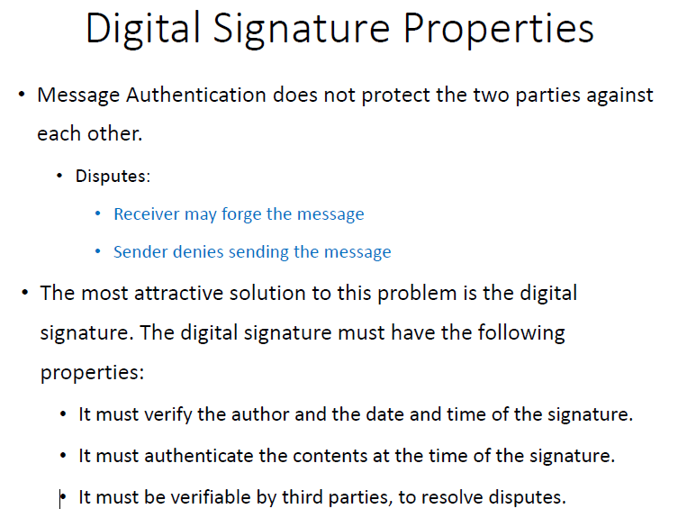

Slide 58
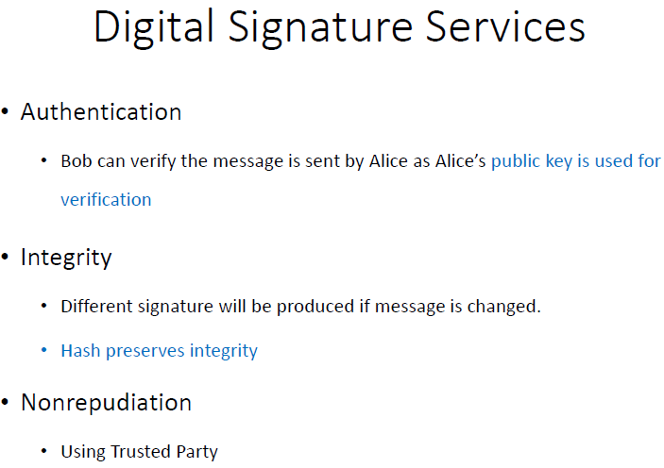

Slide 59
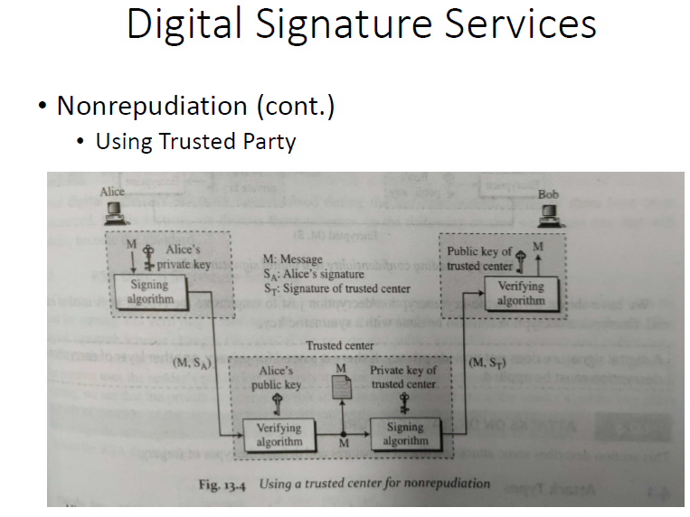

Slide 60
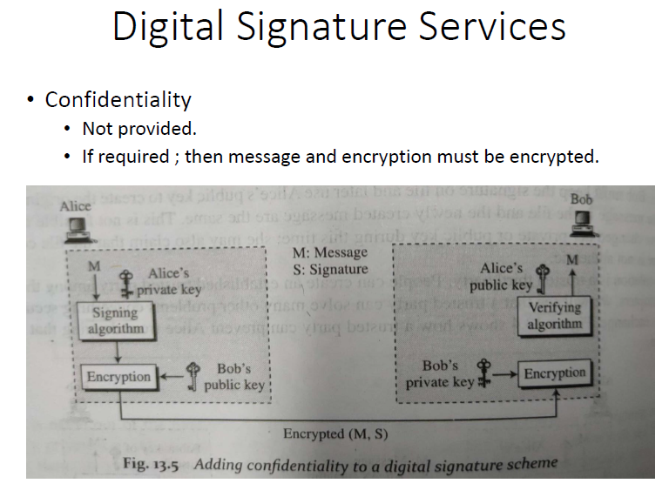

Slide 63
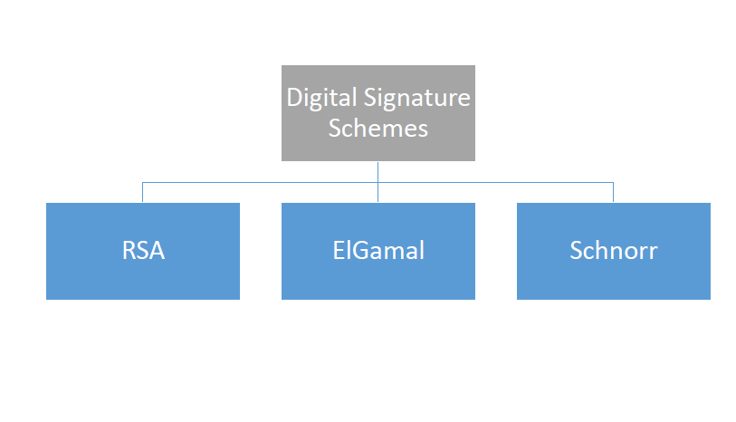

Slide 64
Digital Signature Standard (DSS)
NIST has published Federal Information Processing Standard FIPS186, known as DSS.
Makes use of the Secure Hash Algorithm(SHA)
Originally proposed in 1991 and revised in 1993 in response to public feedback concerning the security of the scheme.

Slide 65
DSS steps

Slide 66
Generation of Global Public Key Components {p,q,g}

Slide 67
Choosing private key and generating public key

Slide 68
Generating Signature {r,s}

Slide 69
Verifying Signature {r,s}

Slide 70
13.6.1 Variations and applications of DSS
Time Stamped Signatures
Sometimes a signed document needs to be time stamped to prevent it from being replayed by an adversary. This is called time-stamped digital signature scheme.
Blind Signatures
Sometimes we have a document that we want to get signed without revealing the contents of the document to the signer.

Slide 71
Undeniable Digital Signatures
Invented by Chaum and Van antwerpen
Has three components –
A signing algorithm
A verification protocol
A disavowal(non-redudiation) protocol
Signing algo allows Alice to sign a message
Verification protocol uses challenge response mechanism & involves Alice in verification; prevents message duplication and distribution without Alice’s approval
Disavowal helps Alice to deny a forged signature

Slide 72
Applications
Certificates and certification authorities have been developed
Following Protocols use services of CA
IPSec
SSL/TLS
S/MIME
PGP

Slide 73
Authentication Applications
Verifying User’s Identity:
Kerberos,
X.509 Authentication Service

Slide 74
Kerberos

Slide 75
Kerberos
In mythology, Kerberos(also known as Cerberus) is a large, three-headed dog that guards the gates to the underworld to keep souls from escaping.
Kerberos is the computer network authentication protocol initially developed in the 1980s by Massachusetts Institute of Technology(MIT) computer scientists.
The idea behind Kerberos is to authenticate users while preventing passwords from being sent over the internet.
It uses secret-key cryptography and a trusted third party for authenticating client-server applications and verifying users‘ identities.
But in the protocol's case, the three heads of Kerberos represent the client, the server, and the Key Distribution Center(KDC).

Slide 76
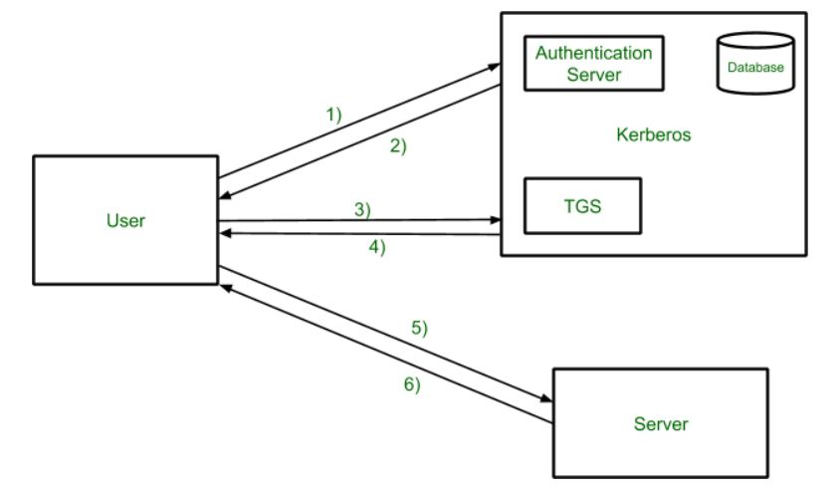

Slide 77
Terms
Authentication server – AS
Ticket granting server – TGS
Key distribution center - KDC

Slide 78
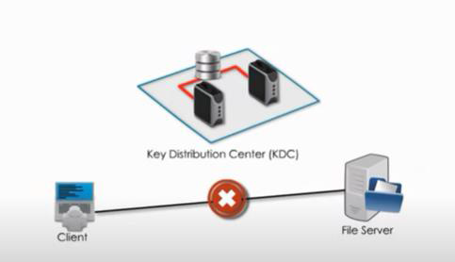
Scenario
Client wants to access file on a server

Slide 79
The client authenticates itself to the Authentication Server (AS) which forwards the username to a key distribution center (KDC).
The KDC issues a time stamped ticket-granting ticket (TGT), and encrypts it using the ticket-granting service's (TGS) secret key and returns the encrypted result to the user's workstation.
This is done infrequently, typically at user logon;
The TGT expires at some point although it may be transparently renewed by the user's session manager while they are logged in.

Slide 80
When the client needs to communicate with a service on another node (a "principal", in Kerberos parlance), the client sends the TGT to the TGS,
The service must have already been registered with the TGS with a Service Principal Name (SPN).
The client uses the SPN to request access to this service.
After verifying that the TGT is valid and that the user has access to a the requested service, the TGS issues ticket and session keys to the client.
The client then sends the ticket to the service server (SS) along with its service request.

Slide 81
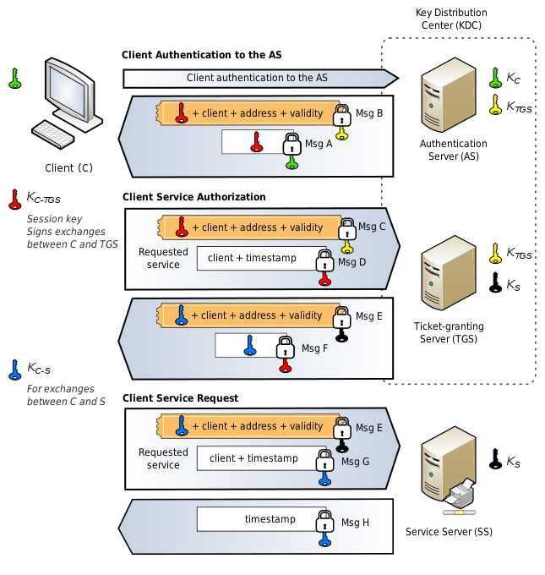

Slide 82
Client authentication
The client sends a cleartext message of the user ID to the requesting services on behalf of the user. (Note: Neither the secret key nor the password is sent to the AS.)
The AS checks if the client is in its database.
If it is, the AS generates the secret key by hashing the password of the user found at the database and sends back the following two messages to the client:
Message A: Client/TGS Session Key encrypted using the secret key of the client/user.
Message B: Ticket-Granting-Ticket (TGT, which includes the client ID, client network address, ticket validity period, and the Client/TGS Session Key) encrypted using the secret key of the TGS.
Once the client receives messages A and B, it attempts to decrypt message A with the secret key generated from the password entered by the user.
If the user entered password does not match the password in the AS database, the client's secret key will be different and thus unable to decrypt message A.
With a valid password and secret key the client decrypts message A to obtain the Client/TGS Session Key.
This session key is used for further communications with the TGS. (Note: The client cannot decrypt Message B, as it is encrypted using TGS's secret key.)
At this point, the client has enough information to authenticate itself to the TGS.

Slide 83
Client Service Authorization
When requesting services, the client sends the following messages to the TGS:
Message C: Composed of the message B (the encrypted TGT using the TGS secret key) and the ID of the requested service.
Message D: Authenticator (which is composed of the client ID and the timestamp), encrypted using the Client/TGS Session Key.
Upon receiving messages C and D, the TGS retrieves message B out of message C.
It decrypts message B using the TGS secret key and gets : Client/TGS Session Key and the client ID (both are in the TGT).
Using this Client/TGS Session Key, the TGS decrypts message D (Authenticator) and compares the client IDs from messages B and D; if they match, the server sends the following two messages to the client:
Message E: Client-to-server ticket (which includes the client ID, client network address, validity period, and Client/Server Session Key) encrypted using the service's secret key.
Message F: Client/Server Session Key encrypted with the Client/TGS Session Key.

Slide 84
Client Service Request
Upon receiving messages E and F from TGS, the client has enough information to authenticate itself to the Service Server (SS).
The client connects to the SS and sends the following two messages:
Message E: From the previous step (the Client-to-server ticket, encrypted using service's secret key).
Message G: A new Authenticator, which includes the client ID, timestamp and is encrypted using Client/Server Session Key.
The SS decrypts the ticket (message E) using its own secret key to retrieve the Client/Server Session Key.
Using the sessions key, SS decrypts the Authenticator and compares client ID from messages E and G, if they match server sends the following message to the client to confirm its true identity and willingness to serve the client:
Message H: The timestamp found in client's Authenticator (plus 1 in version 4, but not necessary in version 5^{[10][11]}), encrypted using the Client/Server Session Key.
The client decrypts the confirmation (message H) using the Client/Server Session Key and checks whether the timestamp is correct.
If so, then the client can trust the server and can start issuing service requests to the server.
The server provides the requested services to the client.

Slide 85
Drawbacks and limitations
Kerberos has strict time requirements, which means that the clocks of the involved hosts must be synchronized within configured limits.
The tickets have a time availability period, and if the host clock is not synchronized with the Kerberos server clock, the authentication will fail.
The default configuration per MIT requires that clock times be no more than five minutes apart.
In practice, Network Time Protocol daemons are usually used to keep the host clocks synchronized
The administration protocol is not standardized and differs between server implementations.
In case of symmetric cryptography adoption (Kerberos can work using symmetric or asymmetric (public-key) cryptography), since all authentications are controlled by a centralized key distribution center (KDC), compromise of this authentication infrastructure will allow an attacker to impersonate any user.
Each network service that requires a different host name will need its own set of Kerberos keys. This complicates virtual hosting and clusters.
Kerberos requires user accounts and services to have a trusted relationship to the Kerberos token server.
The required client trust makes creating staged environments difficult: Either domain trust relationships need to be created that prevent a strict separation of environment domains, or additional user clients need to be provided for each environment.

Slide 86
Can Kerberos Be Hacked?
Yes. Because it is one of the most widely used authentication protocols, hackers have developed several ways to crack into Kerberos.
Most of these hacks take advantage of a vulnerability, weak passwords, or malware – sometimes a combination of all three.
Some of the more successful methods of hacking Kerberos include:
Pass-the-ticket: the process of forging a session key and presenting that forgery to the resource as credentials
Golden Ticket: A ticket that grants a user domain admin access
Silver Ticket: A forged ticket that grants access to a service
Credential stuffing/ Brute force: automated continued attempts to guess a password
Encryption downgrade with Skeleton Key Malware: A malware that can bypass Kerberos, but the attack must have Admin access
DCShadow attack: a new attack where attackers gain enough access inside a network to set up their own DC to use in further infiltration

Slide 87
Digital certificates

Slide 88
In cryptography, a public key certificate, also known as a digital certificate or identity certificate, is an electronic document used to prove the ownership of a public key.
The certificate includes
Information about the key,
Information about the identity of its owner (called the subject), and
The digital signature of an entity that has verified the certificate's contents(called the issuer).

Slide 89
Question
?

